Slide 1

Churn Data Prediction in Telecom Industry
Presented by
Pratheek sreerangam
Pavan Chaitanya.b
Pravalika girneni

Slide 2
Agenda
Problem
Objective
Overview of data
Techniques
Result
Conclusion

Slide 3

Problem:
ABC Wireless network, has asked to develop a model based on customer churn with the aim of classifying the key factors from their existing customer data that impacts customer exit from the network

Slide 4

Objective
Building a model which can predict the customers who are more likely to churn based on the data given by ABC wireless Network.

Slide 5
Overview of Data
Demographics
State
Account length
Area code
International plan
Voice-mail plan
Calling Behaviour
Number of messages, number of calls to customer service
Total day minutes, Total day calls, Total day charge
Total evening minutes, Total evening calls ,Total evening charges
Total night minutes, Total night calls ,Total night charges
Total International minutes, Total International calls,Total International charges

Slide 6
Technique used
What Technique: we are following the Decision tree as our Model.
Why: We believe that to illustrate the influence of numerous variables and their significance in forecasting the result of the target variable, so we will go with Decision Tree approach.

Slide 7
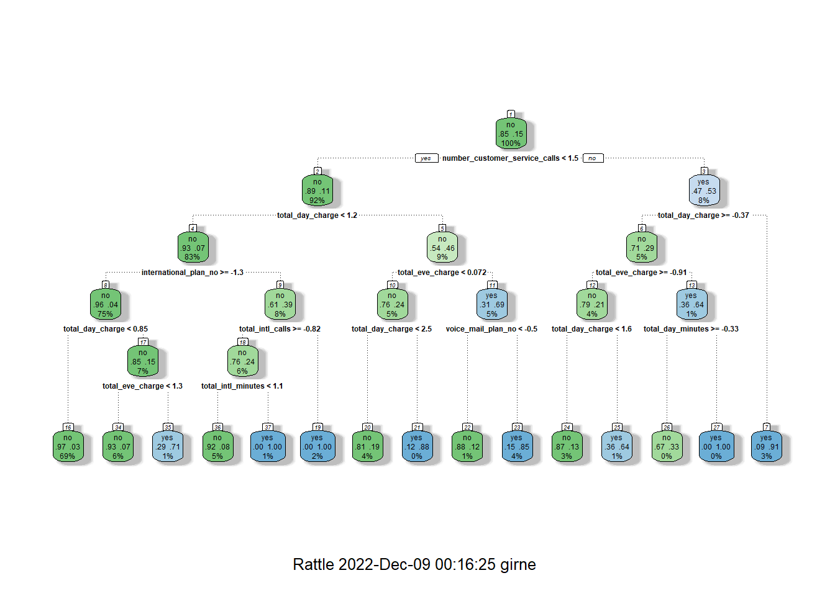
Decision Tree

Slide 8
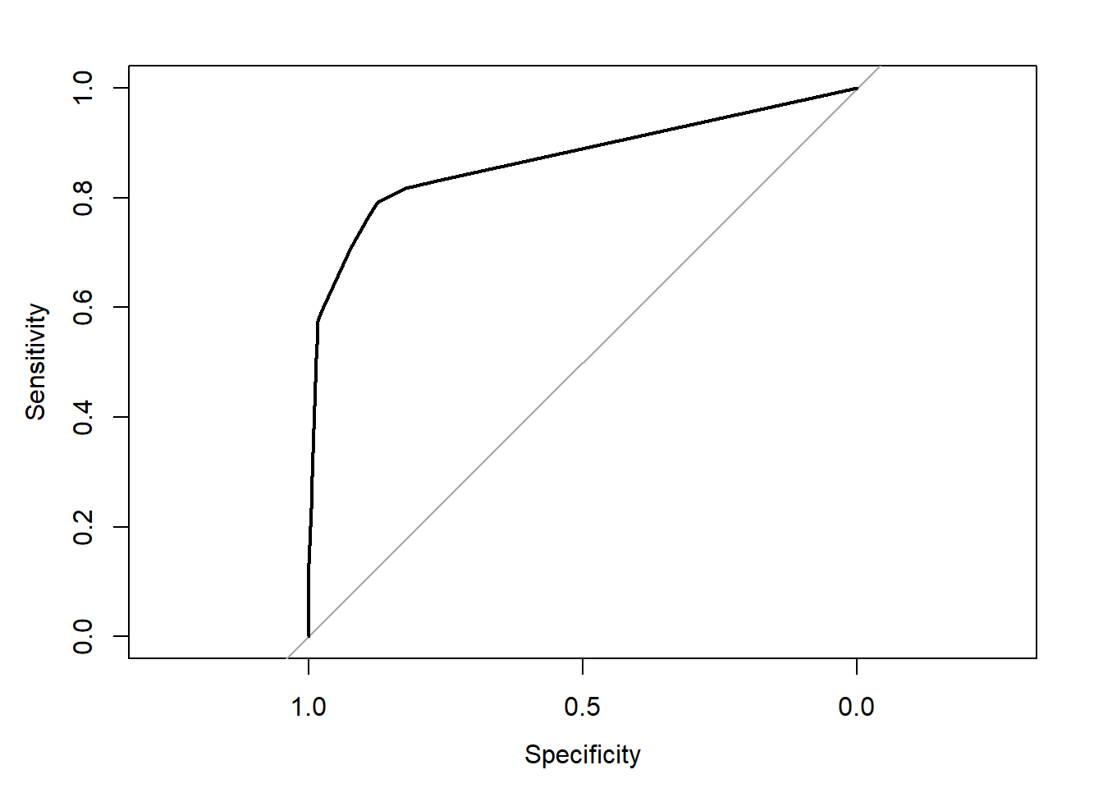
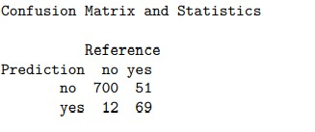
Result
AUC of Model =0.87
Confusion Matrix:

Slide 9
Conclusion
We used the decision Tree classifier as our model and found out the AUC and Accuracy.
As we took the 25 % test data, we are having 1600 customers in test data and we can perform the forecast future churn on them.
the findings are
1453 customers are not ready to move out of ABC wireless network.
147 customers moving from ABC wireless to another network.

Slide 10

Thank you

